Slide 1
API Testing
Prepared By :
Mohamed Ismail
Nouran Hesham
Nouha Ismael

Slide 2
Agenda
What is an API ?
Types of API
What is API Testing ?
How API works ?
What is Advantage of API Testing ?
What is Tools that support API Testing ?
Resources

Slide 3
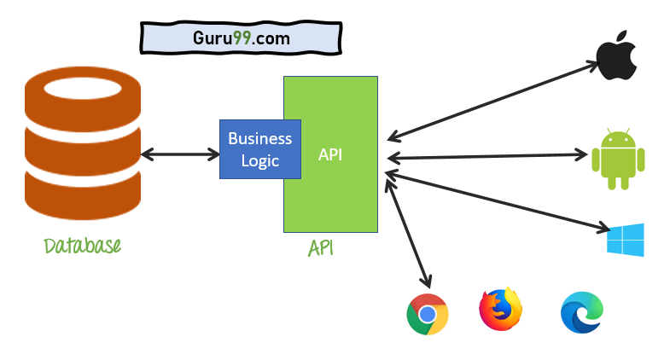
What is an API ?
Application Programming Interface (API) is a software interface that allows two applications to interact with each other without any user intervention

Slide 4
Types of APIs
Online APIs
Offline APIs

Slide 5
APIs vs Web Services
Web Services is an API through the internet.
All Web Services are APIs but not all APIs are Web Services.
Most Format to data at API :
XML (Extensible Markup Language)
Using SOAP (Simple Object Access Protocol)To Transfer data.
JSON (JavaScript Object Notation)
Using REST (Representational State Transfer) To Transfer data.

Slide 6
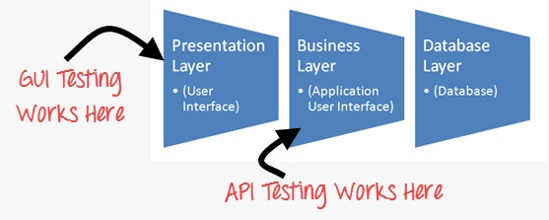
What is API Testing ?
API Testing is a software testing type that validates Application Programming Interfaces (APIs).
The purpose of API Testing is to check the functionality, reliability, performance, and security of the programming interfaces.

Slide 7
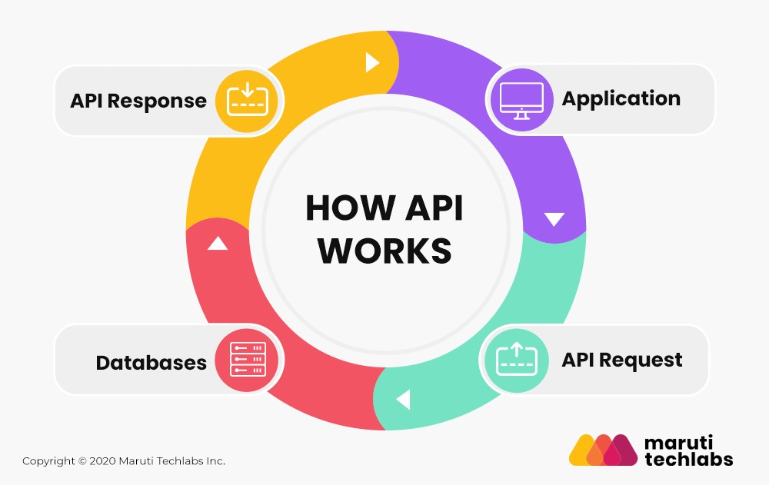
How API works ?

Slide 8
What is Advantage of API Testing ?
Access Without UI
Test for Core Functionality
Time Effective
Language-Independent
Easy Integration With GUI

Slide 9
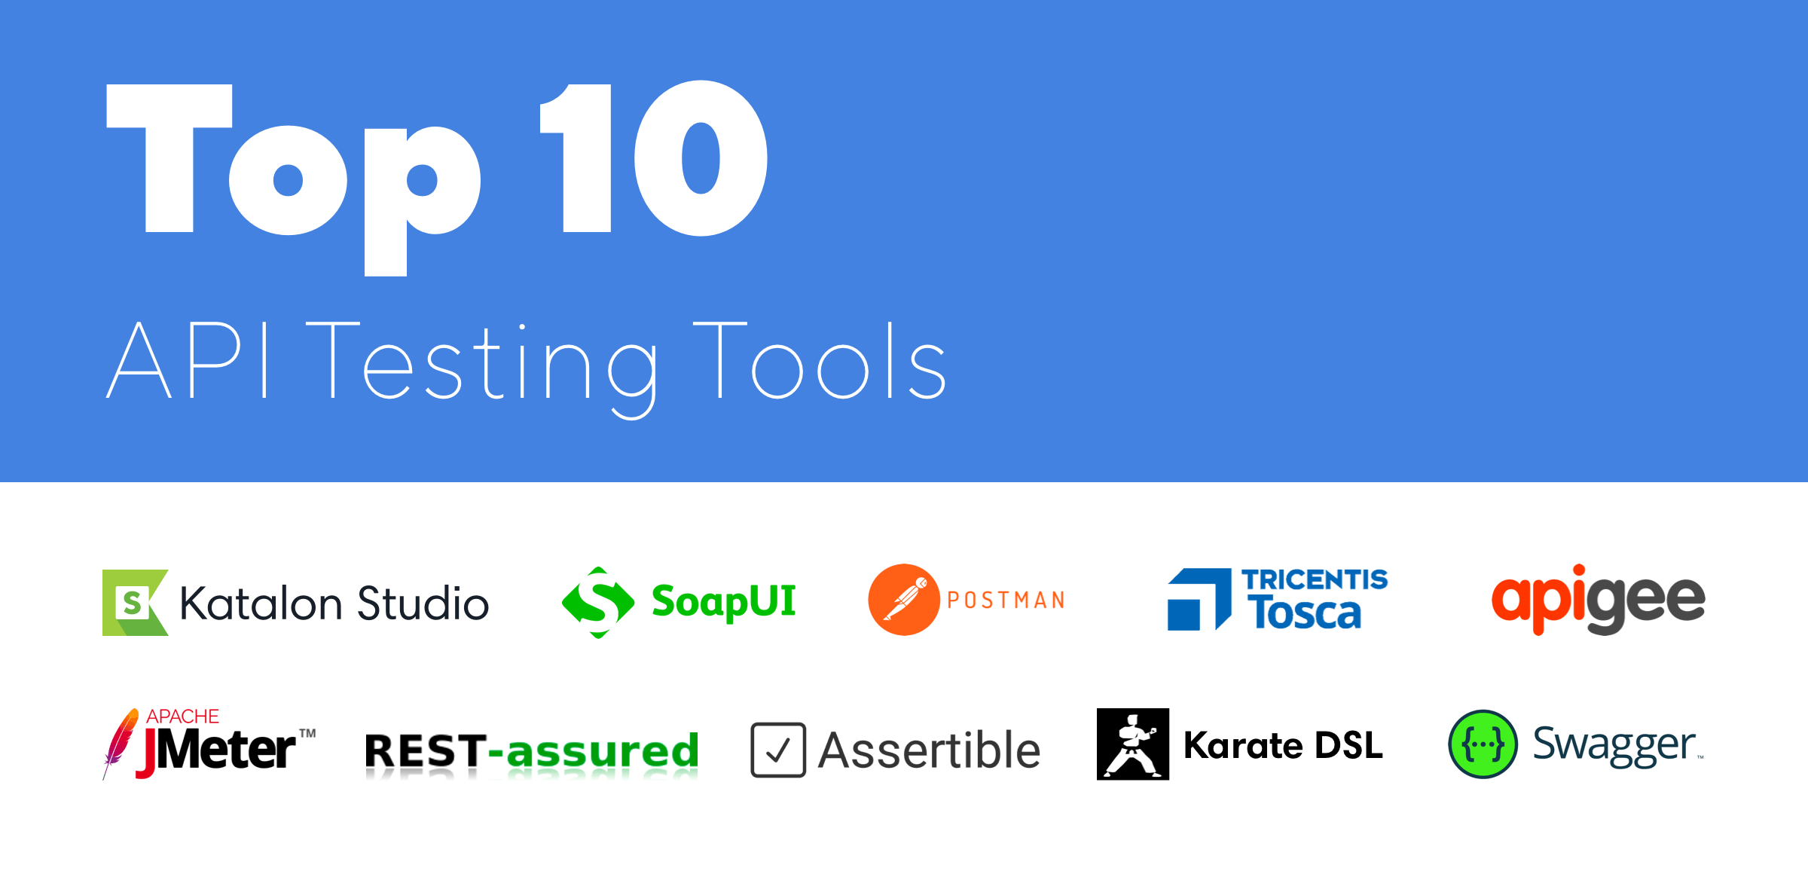
What are Tools that Support API Testing ?

Slide 10
Recourses
- https://www.guru99.com/what-is-api.html#5
- https://www.guru99.com/api-testing.html
- https://zapier.com/learn/apis/chapter-3-data-formats/
- https://www.geeksforgeeks.org/difference-between-json-and-xml/
- https://blog.qasource.com/advantages-of-api-testing/
- https://tcognition.com/exploring-benefits-api-testing/
- https://tcognition.com/exploring-benefits-api-testing/
- https://www.testim.io/blog/the-9-api-testing-tools-you-cant-live-without-in-2019-2/

